Slide 1


Slide 2



Head of School Report
Dr. Stephen Codrington

Slide 3

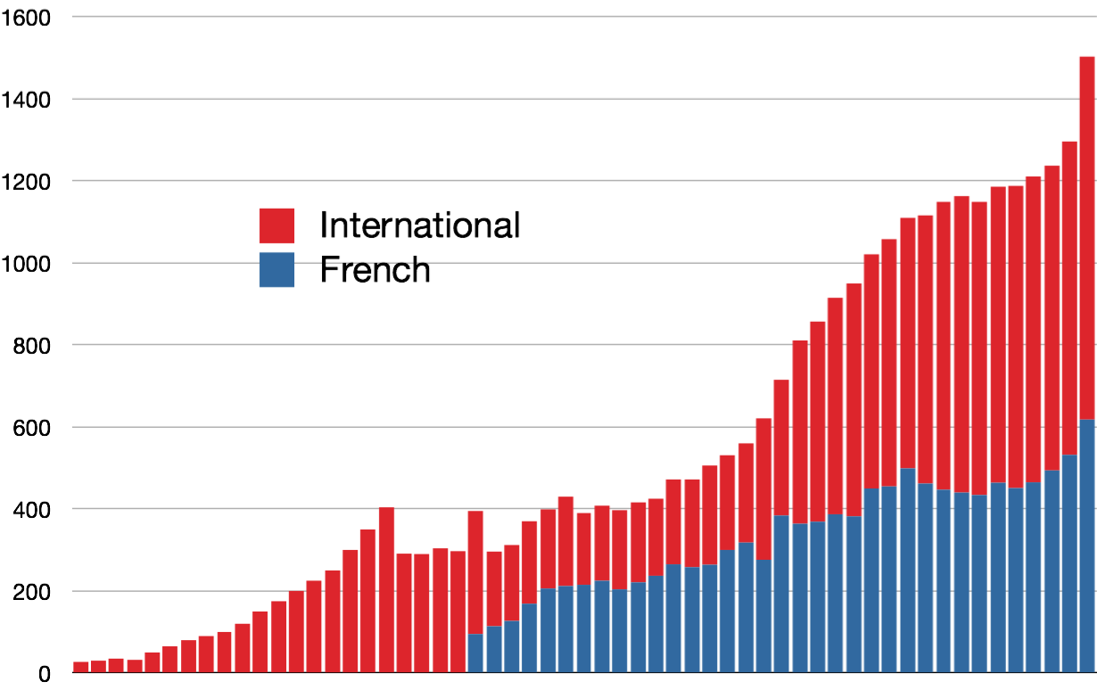
Awty’s Growth 1956-2013
1502
27
1956 1960 1970 1980 1990 2000 2010 2013

Slide 4

With 1,502 students, Awty is now the largest international school in the United States, and the largest independent school in Houston.
Just 18 months ago, we ranked 2nd and 3rd respectively on these criteria.

Slide 5

Mix of French and International Sections
 | PK3 PS | PK4 MS | K GS | 1 CP | 2 CE1 | 3 CE2 | 4 CM1 | 5 CM2 | 6 6ème | 7 5ème | 8 4ème | 9 3ème | 10 2ème | 11 1ère | 12 Tle | Tot.
FBS | 21 | 34 | 42 | 59 | 57 | 55 | 50 | 59 | 36 | 41 | 43 | 38 | 27 | 28 | 27 | 619
IS | 46 | 46 | 49 | 54 | 52 | 55 | 52 | 54 | 72 | 54 | 54 | 85 | 68 | 78 | 64 | 883
Tot. | 67 | 80 | 91 | 113 | 109 | 110 | 104 | 113 | 108 | 95 | 97 | 123 | 95 | 106 | 91 | 1502
 | 238 |  |  | 549 |  |  |  |  | 300 |  |  | 415 |  |  |  | 1502
International Section = 58.9%
French Bilingual Section = 41.2%

Slide 6
Confirmed enrollments for 2013-2014 (so far)
 | PK3 PS | PK4 MS | K GS | 1 CP | 2 CE1 | 3 CE2 | 4 CM1 | 5 CM2 | 6 6ème | 7 5ème | 8 4ème | 9 3ème | 10 2ème | 11 1ère | 12 Tle | Tot.
FBS | 16 | 27 | 43 | 48 | 55 | 55 | 54 | 52 | 57 | 35 | 36 | 42 | 35 | 24 | 25 | 604
IS | 37 | 47 | 47 | 49 | 50 | 53 | 54 | 51 | 61 | 67 | 51 | 73 | 80 | 59 | 77 | 856
Tot. | 53 | 74 | 90 | 97 | 105 | 108 | 108 | 103 | 118 | 102 | 87 | 115 | 115 | 83 | 102 | 1460
of whom new students are:
FBS | 16 | 6 | 11 | 9 | 2 | 5 | 3 | 2 | 6 | 3 | 0 | 4 | 2 | 3 | 1 | 73
IS | 37 | 3 | 6 | 6 | 2 | 3 | 2 | 2 | 9 | 0 | 1 | 27 | 3 | 4 | 1 | 106
Tot. | 53 | 9 | 17 | 15 | 4 | 8 | 5 | 4 | 15 | 3 | 1 | 31 | 5 | 7 | 2 | 179

Slide 7
Admissions growth will slow down
As a result of these changes, the % of students in the FBS will increase.
 | PK3 PS | PK4 MS | K GS | 1 CP | 2 CE1 | 3 CE2 | 4 CM1 | 5 CM2 | 6 6ème | 7 5ème | 8 4ème | 9 3ème | 10 2ème | 11 1ère | 12 Tle | Tot.
FBS | 16 | 27 | 43 | 48 | 55 | 55 | 54 | 52 | 57 | 35 | 36 | 42 | 35 | 24 | 25 | 604
IS | 37 | 47 | 47 | 49 | 50 | 53 | 54 | 51 | 61 | 67 | 51 | 73 | 80 | 59 | 77 | 856
Tot. | 53 | 74 | 90 | 97 | 105 | 108 | 108 | 103 | 118 | 102 | 87 | 115 | 115 | 83 | 102 | 1460
of whom new students are:
Maximum class sizes to be reduced to 16 students
Maximum class sizes to remain at 18 students for the International Section, and up to 23 or so (flexible) for the French Bilingual Section
Maximum class sizes to be reduced to 16 students for the International Section, and remain up to 23 or so (flexible) for the French Bilingual Section
FBS | 16 | 6 | 11 | 9 | 2 | 5 | 3 | 2 | 6 | 3 | 0 | 4 | 2 | 3 | 1 | 73
IS | 37 | 3 | 6 | 6 | 2 | 3 | 2 | 2 | 9 | 0 | 1 | 27 | 3 | 4 | 1 | 106
Tot. | 53 | 9 | 17 | 15 | 4 | 8 | 5 | 4 | 15 | 3 | 1 | 31 | 5 | 7 | 2 | 179

Slide 8

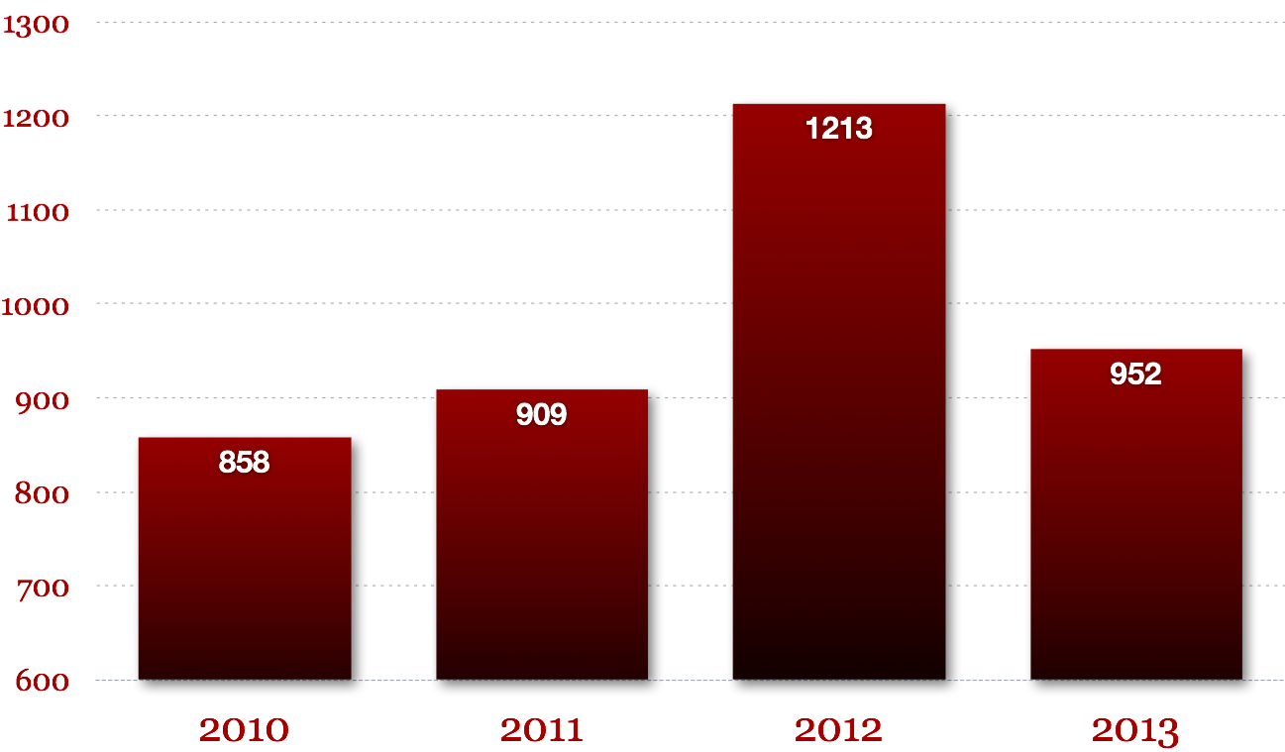
Application numbers, 2010-2013
770 for the International Section
182 for the French Bilingual Section

Slide 9
Acceptances 2013 (so far)
770 for the International Section
182 for the French Bilingual Section
106 accepted
73 accepted

Slide 10
Application numbers, 2012-13
 | International Section |  |  |  | French Section |  |  |  | Overall Total
 | Lower School | Middle School | Upper School | TOTAL | Lower School | Middle School | Upper School | TOTAL
No. of applicants | 553 | 181 | 193 | 927 | 224 | 43 | 35 | 302 | 1229
No. Awty accepted | 187 | 61 | 114 | 362 | 161 | 42 | 30 | 233 | 595
No. enrolled | 133 | 36 | 69 | 238 | 129 | 28 | 25 | 182 | 420

Slide 11
Application percentages, 2012-13
 | International Section |  |  |  | French Section |  |  |  | Overall Total
 | Lower School | Middle School | Upper School | TOTAL | Lower School | Middle School | Upper School | TOTAL
%. of applicants |  |  |  | 75% of total |  |  |  | 25% of total | 100%
% Awty accepted
% enrolled

Slide 12
Application percentages, 2012-13
 | International Section |  |  |  | French Section |  |  |  | Overall Total
 | Lower School | Middle School | Upper School | TOTAL | Lower School | Middle School | Upper School | TOTAL
%. of applicants | 71% of LS | 81% of MS | 71% of US | 75% of total | 29% of LS | 19% of MS | 29% of US | 25% of total | 100%
% Awty accepted
% enrolled

Slide 13
Application percentages, 2012-13
 | International Section |  |  |  | French Section |  |  |  | Overall Total
 | Lower School | Middle School | Upper School | TOTAL | Lower School | Middle School | Upper School | TOTAL
%. of applicants | 71% of LS | 81% of MS | 71% of US | 100% | 29% of LS | 19% of MS | 29% of US | 100% | 100%
% Awty accepted |  |  |  | 39% |  |  |  | 77% | 48%
% enrolled
of
which
of
which
of
which
in all rounds of offers, not just first round

Slide 14
Application percentages, 2012-13
 | International Section |  |  |  | French Section |  |  |  | Overall Total
 | Lower School | Middle School | Upper School | TOTAL | Lower School | Middle School | Upper School | TOTAL
%. of applicants | 100% | 100% | 100% | 75% of total | 100% | 100% | 100% | 25% of total | 100%
% Awty accepted | 34% | 34% | 59% | 39% | 72% | 98% | 86% | 77% | 48%
% enrolled
of
which
of
which
of
which
of
which
of
which
of
which

Slide 15
Application percentages, 2012-13
 | International Section |  |  |  | French Section |  |  |  | Overall Total
 | Lower School | Middle School | Upper School | TOTAL | Lower School | Middle School | Upper School | TOTAL
%. of applicants | 71% of LS | 81% of MS | 71% of US | 75% of total | 29% of LS | 19% of MS | 29% of US | 25% of total | 100%
% Awty accepted | 34% | 34% | 59% | 39% | 72% | 98% | 86% | 77% | 48%
% enrolled |  |  |  | 66% |  |  |  | 78% | 71%
of
which
of
which
of
which

Slide 16
Application percentages, 2012-13
 | International Section |  |  |  | French Section |  |  |  | Overall Total
 | Lower School | Middle School | Upper School | TOTAL | Lower School | Middle School | Upper School | TOTAL
%. of applicants | 71% of LS | 81% of MS | 71% of US | 75% of total | 29% of LS | 19% of MS | 29% of US | 25% of total | 100%
% Awty accepted | 34% | 34% | 59% | 39% | 72% | 98% | 86% | 77% | 48%
% enrolled | 71% | 59% | 61% | 66% | 80% | 67% | 83% | 78% | 71%
of
which
of
which
of
which
of
which
of
which
of
which

Slide 17
Application percentages, 2012-13
 | International Section |  |  |  | French Section |  |  |  | Overall Total
 | Lower School | Middle School | Upper School | TOTAL | Lower School | Middle School | Upper School | TOTAL
No. of applicants | 553 | 181 | 193 | 927 | 224 | 43 | 35 | 302 | 1229
% enrolled | 24% | 20% | 36% | 27% | 58% | 65% | 71% | 60% | 34%
of
whom
of
whom
of
whom
of
whom
of
whom
of
whom
of
whom
of
whom
of
whom
2013 figures 14% 40% 19%

Slide 18

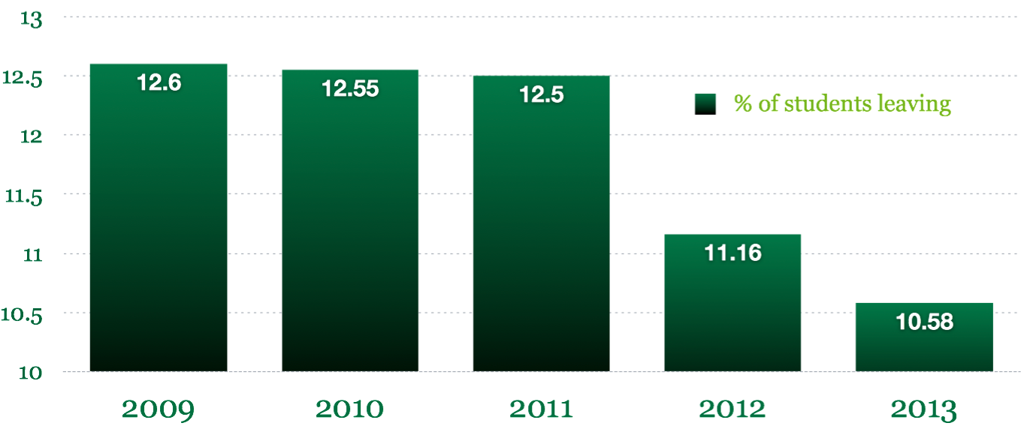
Student attrition rates
5.7% for the International Section
9.3% for the French Bilingual Section
(excluding Grade 12/Terminale leavers)

Slide 19

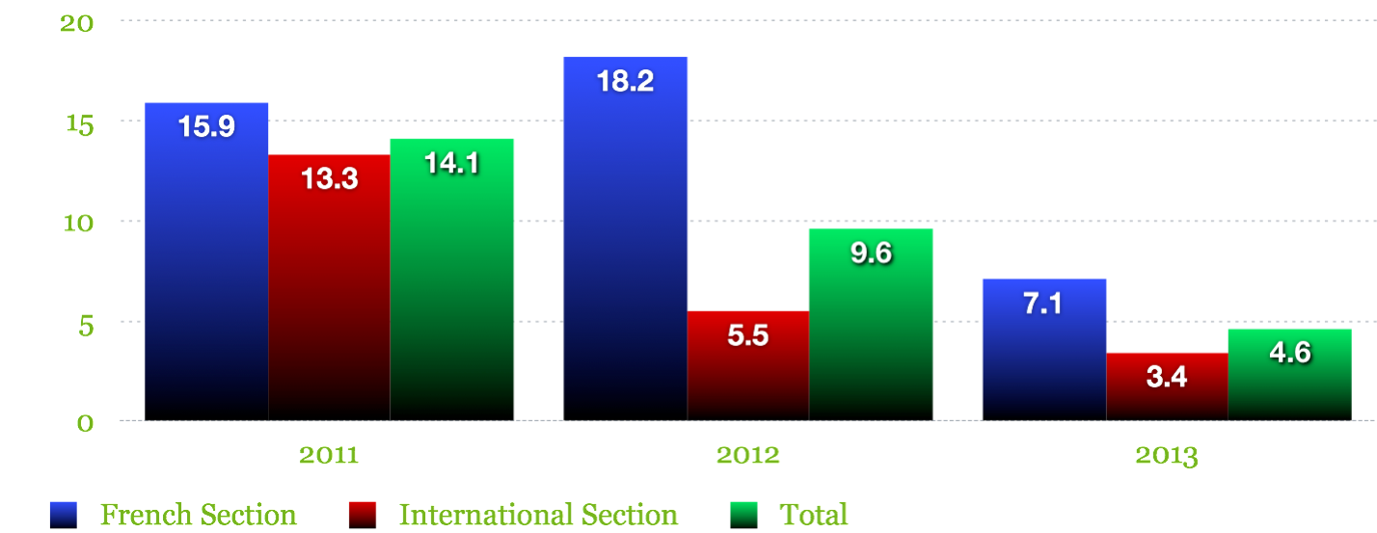
Faculty attrition rates

Slide 20

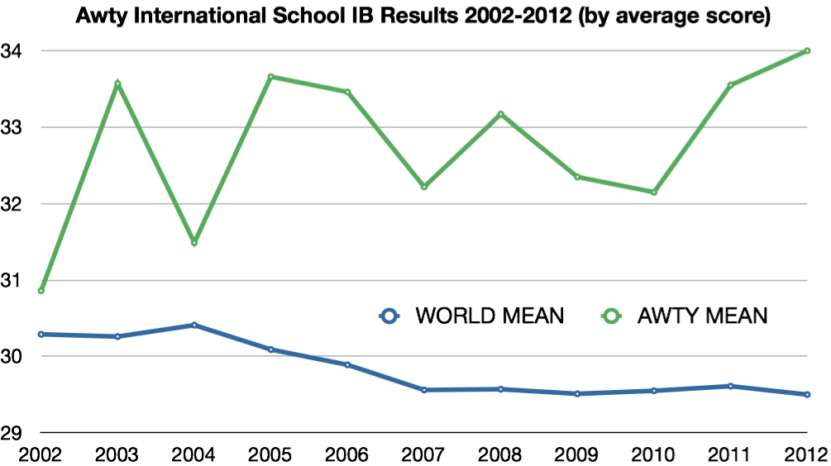
Student Outcomes
Student outcomes measure overall success of mission (persistence and graduation rates are a proxy for effective preparation academically to succeed in future competitive academic environments.

Slide 21
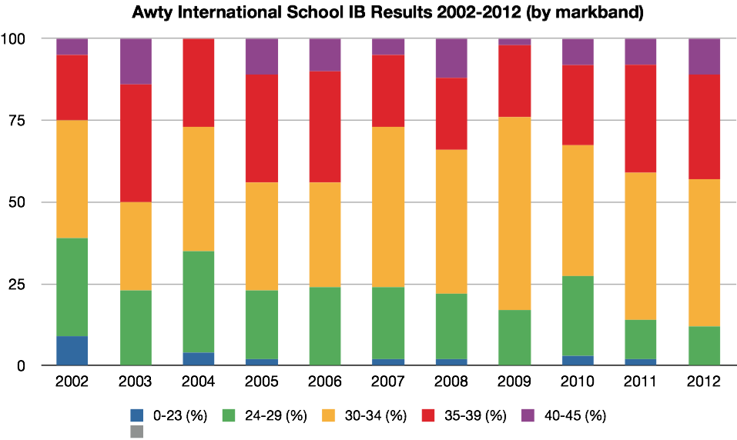
Student Outcomes
Student outcomes measure overall success of mission (persistence and graduation rates are a proxy for effective preparation academically to succeed in future competitive academic environments.

Slide 22

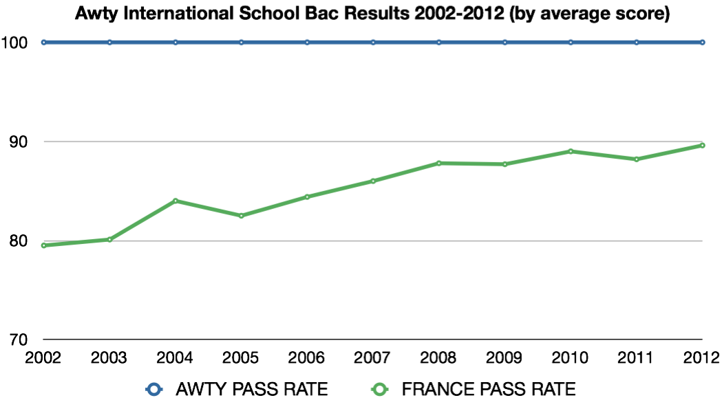
Student Outcomes
Student outcomes measure overall success of mission (persistence and graduation rates are a proxy for effective preparation academically to succeed in future competitive academic environments.

Slide 23
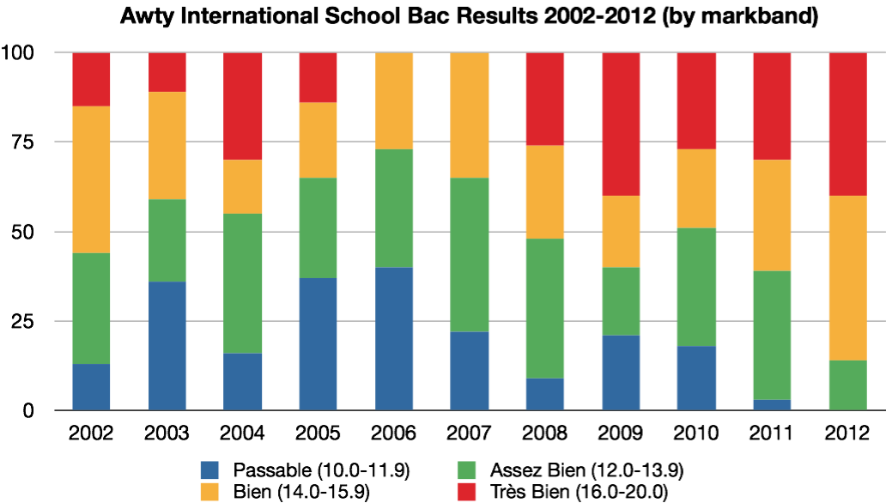
Student Outcomes
Student outcomes measure overall success of mission (persistence and graduation rates are a proxy for effective preparation academically to succeed in future competitive academic environments.

Slide 24


Curriculum Initiative
The International Baccalaureate Primary Years Program in the International Section of the Lower School
PYP

Slide 25




The IB has 4 programs
Grades 11 and 12
Grades 6 to 10
Grades PK to 5
Grades 11 and 12

Slide 26



The IB has 4 programs
Six subject areas, standard and higher levels
Theory of Knowledge
CAS
Extended Essay

Slide 27

The IB has 4 programs
Eight subject areas
Areas of interaction
Personal project
Constructivist enquiry learning

Slide 28
The IB has 4 programs
The whole child
Specified subjects, reading, math, science, social studies
Four or six transdisciplinary units, based on six PYP themes
Constructivist enquiry learning
Portfolio
Exhibition for 5th Graders

Slide 29
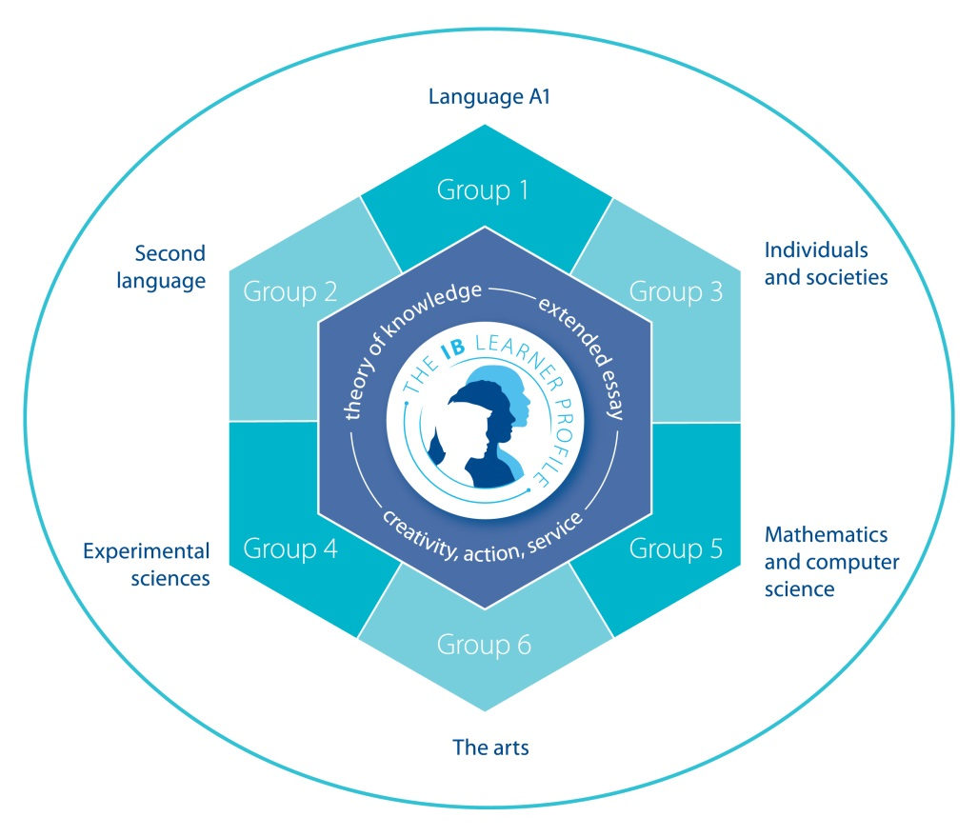
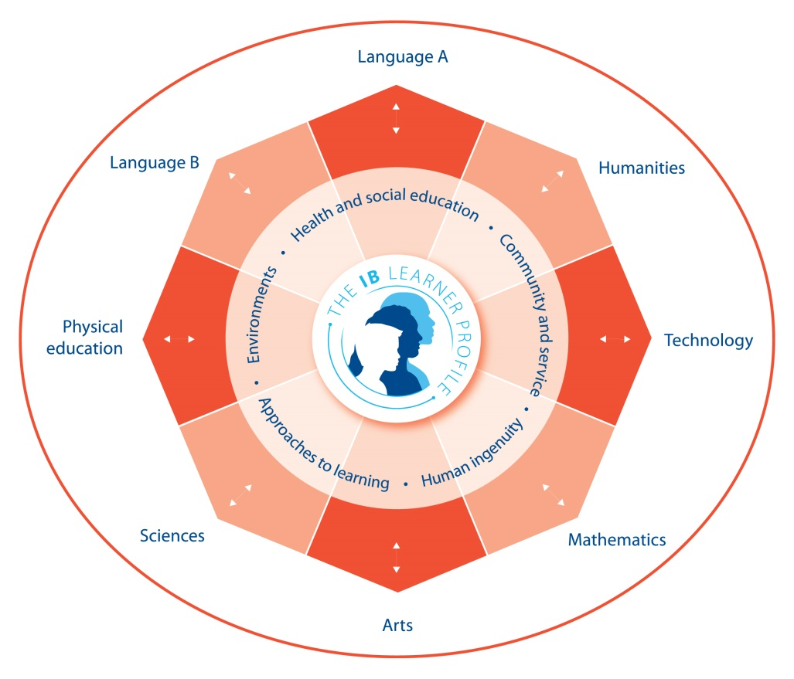
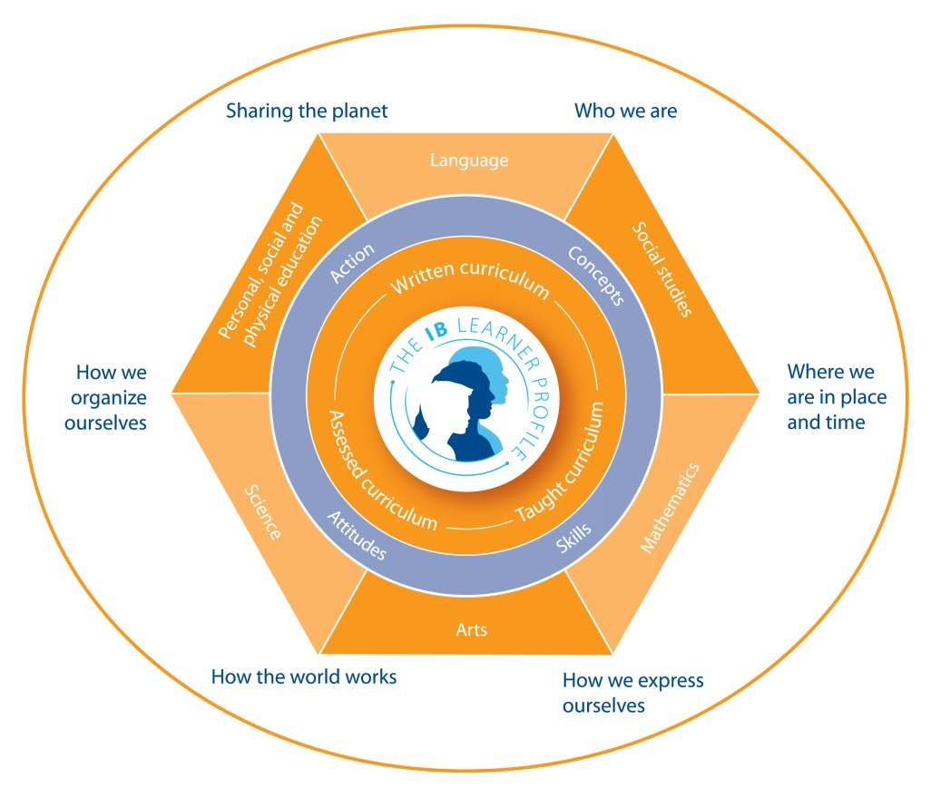
The IB has 4 programs

Slide 30
Common threads to all IB programs
A broad and balanced range of subjects, including a second language
International-mindedness
Transdisciplinary learning
Community service component requiring action and reflection.
A positive attitude to learning by encouraging students to ask challenging questions, to critically reflect, to develop research skills, and to learn how to learn.
Learner profile and IB Attitudes

Slide 31
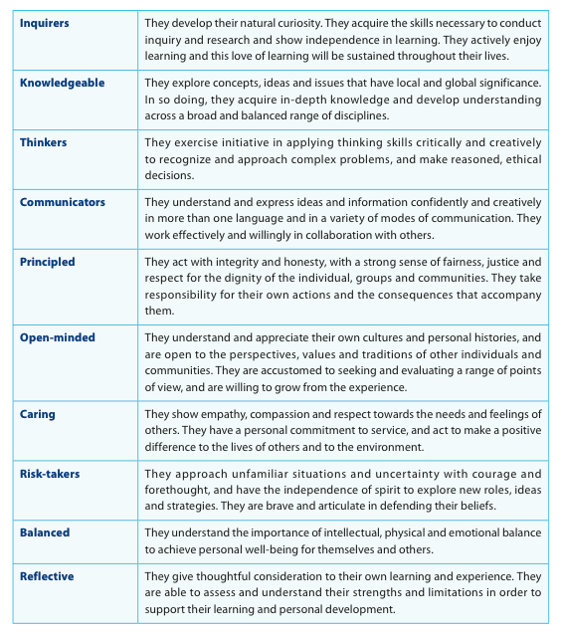
IB Learner Profile

Slide 32
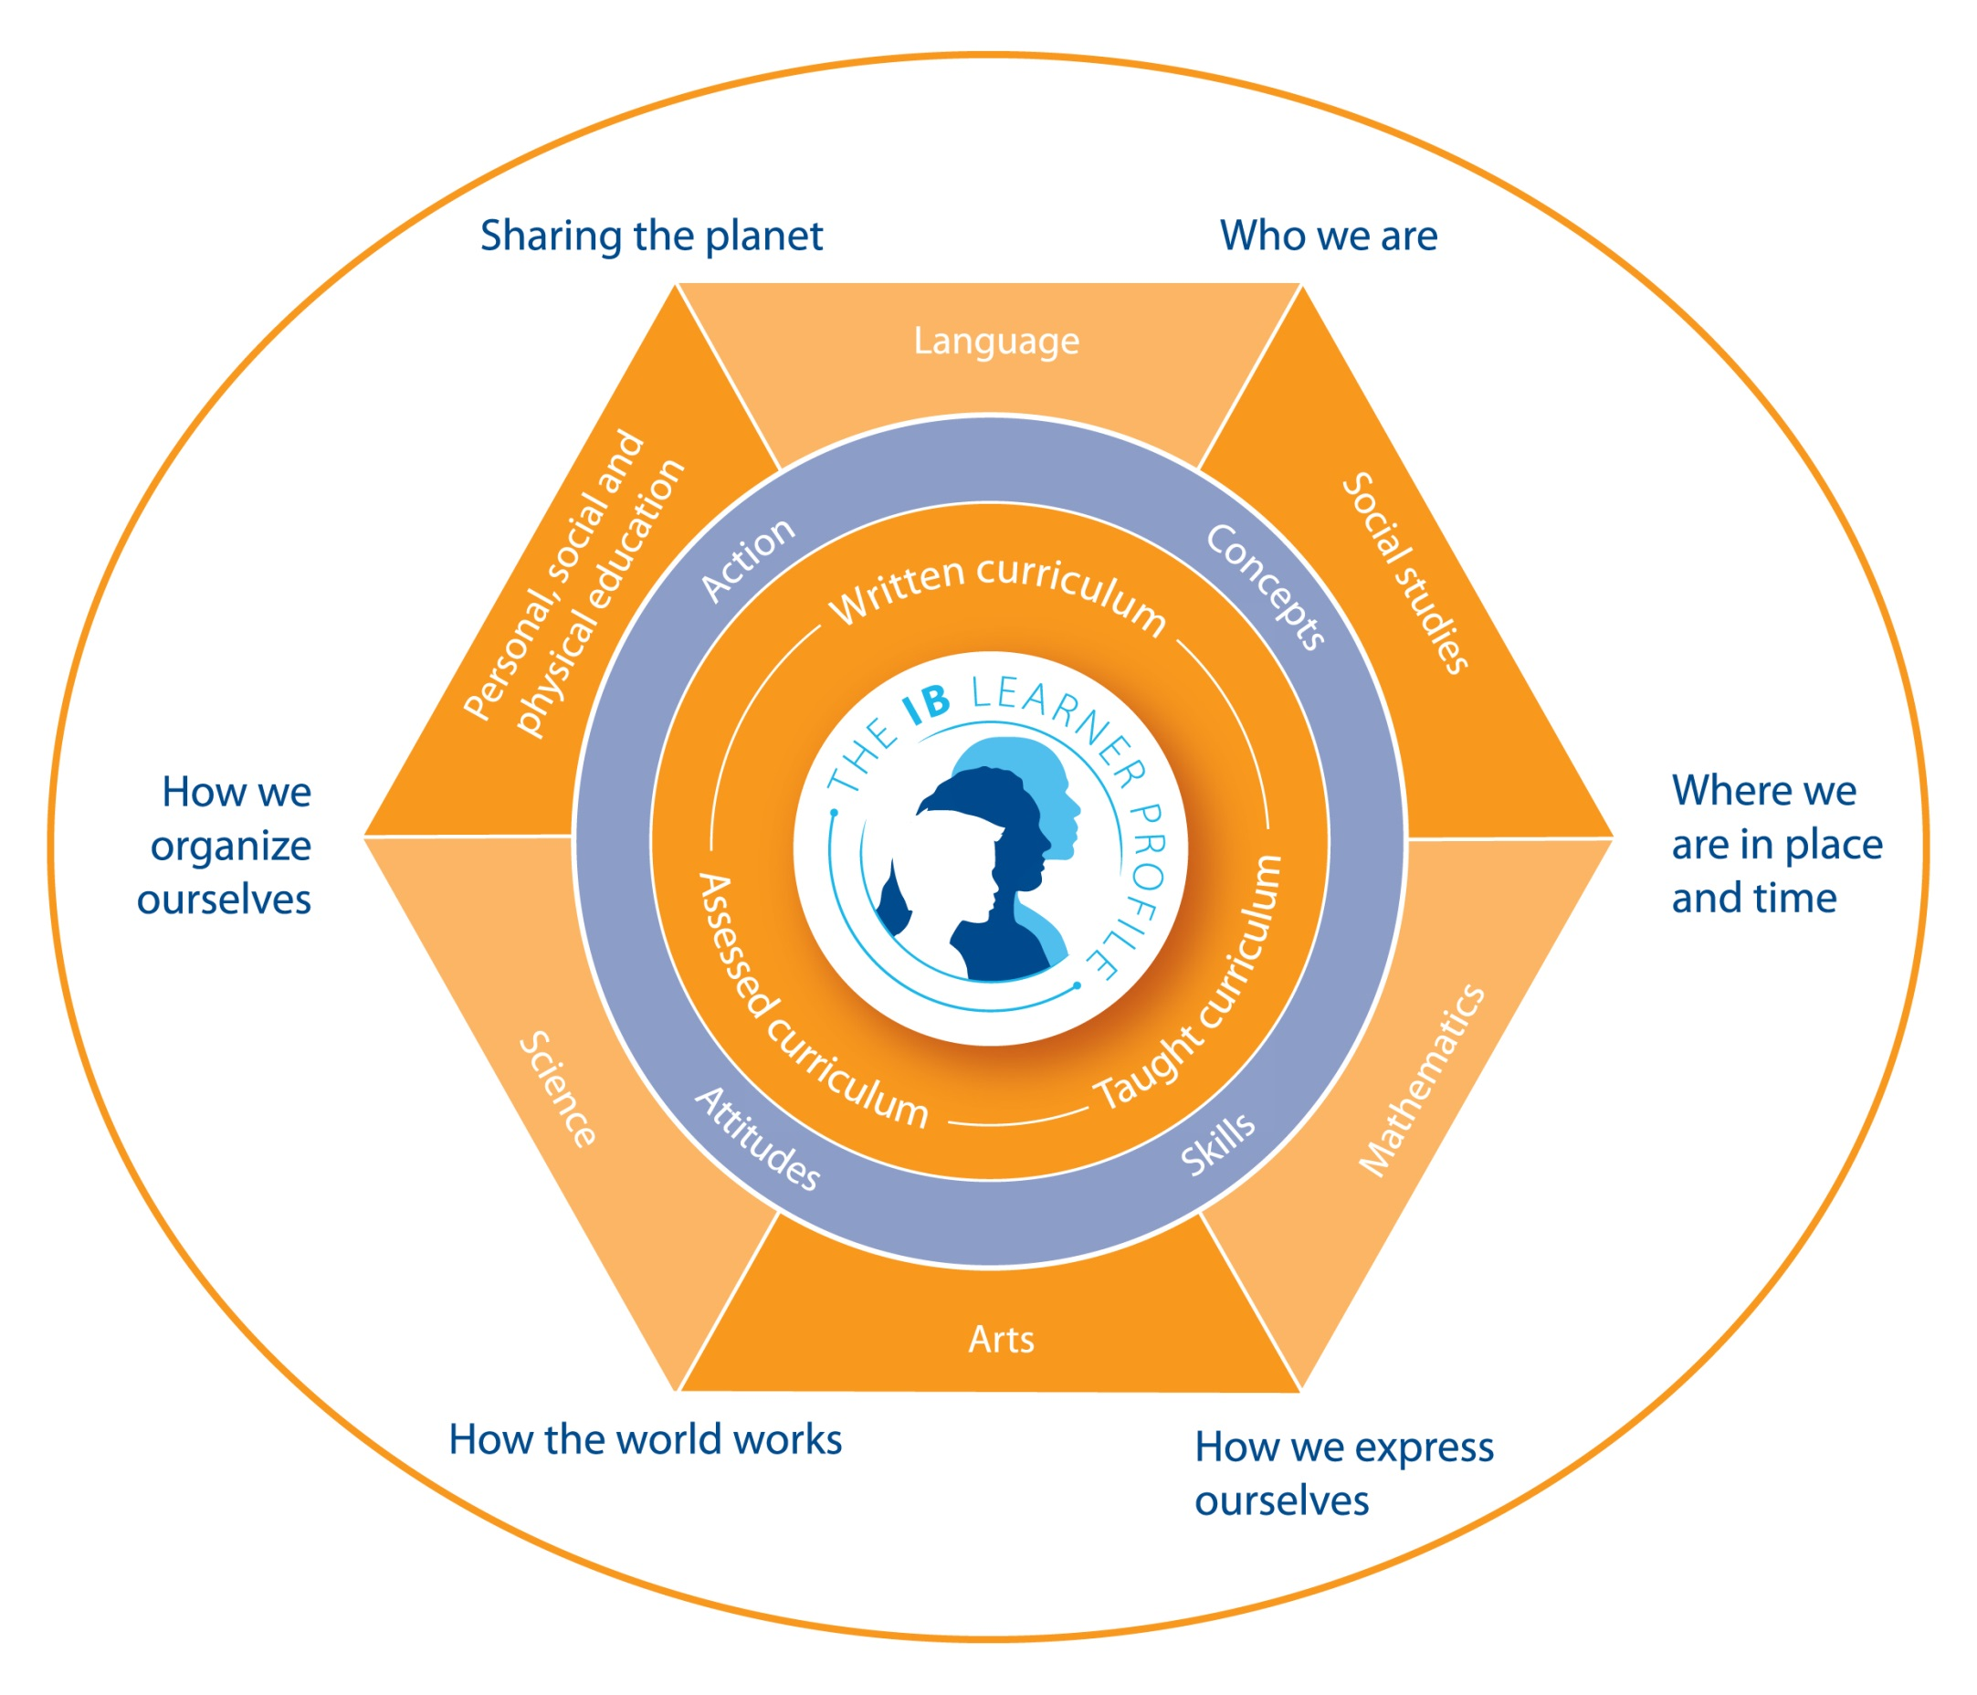
The PYP

Slide 33
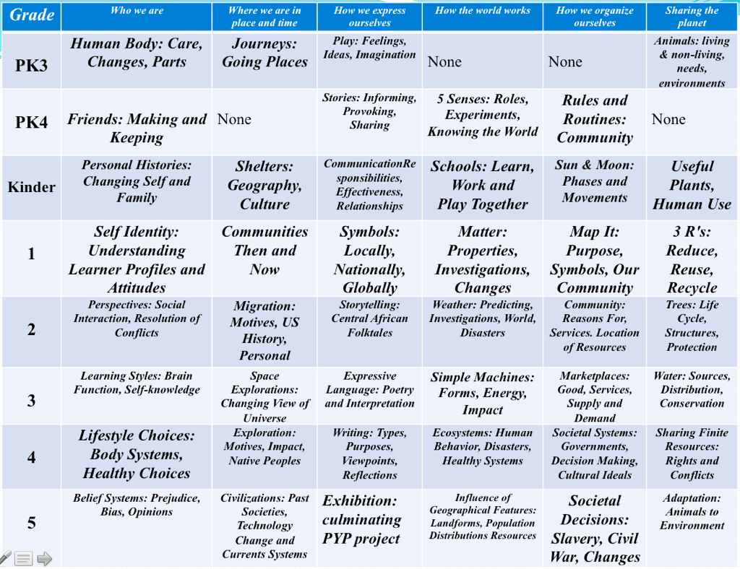

Slide 34


Why consider PYP for Awty?
  Awty Success with IB Diploma
  Curriculum Unity and Coordination
  Teacher Training Connected to Instruction
  Match with Awty Mission and Direction
  Being a Part of a Larger Whole: World Standard
  Suits Internationally Mobile Students
  Inquiry Method: Intellectual Challenge
  International Resources - access to the best
  Learner Profile and Attitudes

Slide 35
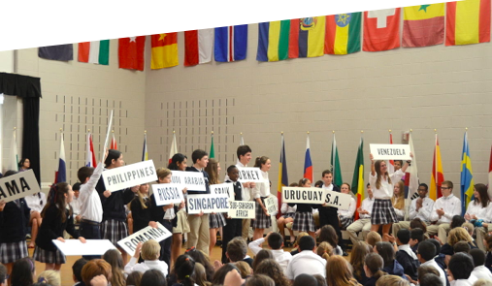
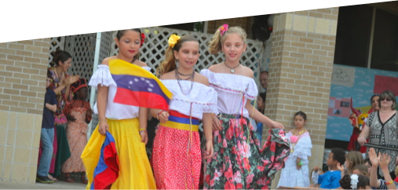
Timeline 2013-2014
Curriculum coordinator
Vertical Alignment for PK3 to 5th grade
Monthly Themes Continued
Service Learning Projects in All Grades
Teacher Professional Development on Inquiry, Thematic Teaching, Technology

Slide 36

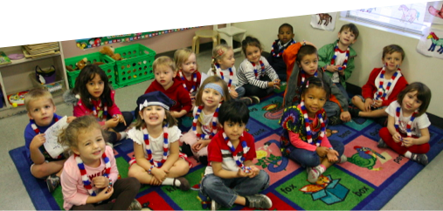
Timeline 2014-2015
Revising Thematic Units
Develop research strand for K to 5. Teachers will define and document research skills for their students from kindergarten to grade 5 in 2014-2015.
Guided Inquiry in Units
Formal application for IB affiliation after internal issues are resolved.

Slide 37

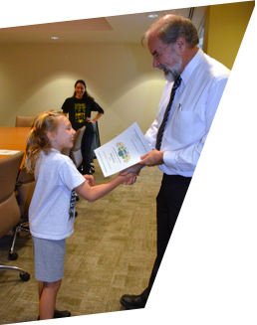
Other initiatives
Suggestion boxes
New Languages Policy
BYOD scheme implemented
Gap in teachers’ salaries fixed
Refined the organizational chart
Lower School extension starting soon
+Works now in Lower and Middle Schools
Fixing gaps in records of teacher qualifications
Service Learning has replaced Community Service
Appointment of a sustainable Sustainability Coordinator
Appointment of a Curriculum Coordinator for Lower School

Slide 38

Boualem Maizia
Proviseur, Deputy Head of School

Slide 39
Enrollment since 1999
 | French Section | International Section
1999-00 | 382 | 568
2000-01 | 450 | 571
2001-02 | 455 | 603
2002-03 | 499 | 611
2003-04 | 462 | 654
2004-05 | 447 | 702
2005-06 | 440 | 723
2006-07 | 434 | 715
2007-08 | 464 | 722
2008-09 | 451 | 737
2009-10 | 466 | 746
2010-11 | 484 | 736
2011-12 | 535 | 757
2012-13 | 619 | 885

Slide 40
Enrollment May 6,2013

Slide 41
Effectifs par niveau
 | Students | Number of classes | Average per class
PK 3 | 21 | 2 | -
PK 4 | 33 | 3 | -
K | 42 | 4 | -
1st | 60 | 3 | 20
2nd | 57 | 3 | 19
3rd | 55 | 3 | 18,3
4th | 52 | 3
5th | 59 | 3
6th | 36 | 2 | 18
7th | 41 | 2 | 20,5
8th | 43 | 2 | 21,5
9th | 38 | 2 | 19
10th | 27 | 2 | 13,5
11th | 28 | ES, L, S | 10+3+18
12th | 27 | ES, L, S | 7+2+18
 | 619

Slide 42

Répartition des sections

Slide 43
New students
Year | New | Enrollment | Percentage
2009 | 96 | 474 | 20.25 %
2010 | 105 | 499 | 21.04 %
2011 | 130 | 535 | 24.29 %
2012 | 182 | 619 | 29.44 %

Slide 44
Nationalities
Français et bi-nationaux : 457 (73.8%) dont Français : 324 (52.3%) et Français/US : 95 (15.3%)
Américains : 88 (14.2%)
Autres nationalités : 74 (10.6%)

Slide 45
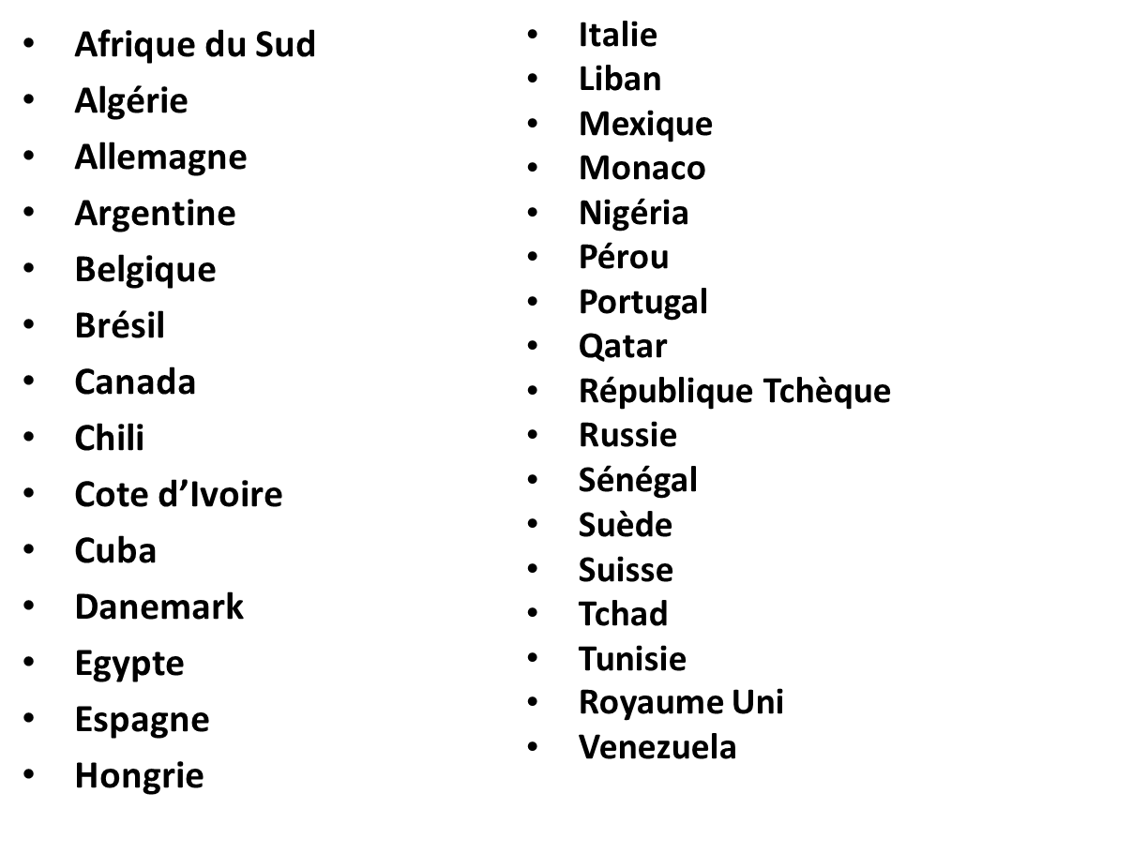
Other nationalities

Slide 46
Enrollment 2013-2014

Slide 47
 | 2012-13 |  | 2012-13 As of April 30th, 2013
PK 3- PS | 21 | Preschool: 96 | 16 | Preschool: 87
PK 4- MS | 33 |  | 27
K- GS | 42 |  | 44
1st - CP | 60 | Lower School: 283 | 48 | Lower School: 261
2nd - CE1 | 57 |  | 53
3rd - CE2 | 55 |  | 56
4th - CM1 | 52 |  | 53
5th - CM2 | 59 |  | 51
6th - 6ème | 36 | Middle School: 120 | 59 | Middle School: 134
7th - 5ème | 41 |  | 38
8th - 4ème | 43 |  | 37
9th - 3ème | 38 | Upper School: 120 | 42 | Upper School: 127
10th - 2nde | 27 |  | 36
11th - 1ère | 28 |  | 24
12th - Term | 27 |  | 25
Total | 619 |  | 609

Slide 48
Departures
 | PS | LS | MS | US | Total
2003 | 17 | 73 | 38 | 14 | 142
2004 | 16 | 35 | 25 | 13 | 89
2005 | 9 | 29 | 35 | 18 | 91
2006 | 20 | 40 | 26 | 10 | 96
2007 | 11 | 26 | 33 | 20 | 90
2008 | 12 | 35 | 36 | 10 | 93
2009 | 11 | 48 | 37 | 6 | 102
2010 | 14 | 32 | 23 | 8 | 77
2011 | 6 | 30 | 33 | 17 | 86
2012 | 5 | 34 | 21 | 4 | 64
2013* April 30 | 2 | 25 | 13 | 18 | 58

Slide 49
 | Transfert I S | Departs | Renrollment /Pending | New | Transfert FS
PK3 |  |  |  | 16 |  | 16
PK4 |  | 0 | 21 | 6 |  | 27
K |  | -2 | 32 | 12 |  | 44
1st | -2 | -4 | 38 | 10 | 1 | 49
2nd |  | -6 | 51 | 2 |  | 53
3rd | -1 | -6 | 51 | 6 |  | 57
4th |  | -5 | 50 | 3 |  | 53
5th | -2 | -4 | 48 | 3 | 2 | 53
6th | -3 | -7 | 52 | 7 |  | 59
7th |  | -3 | 33 | 5 |  | 38
8th |  | -3 | 38 | 1 |  | 39
9th |  | -4 | 39 | 4 |  | 43
10th |  | -5 | 33 | 3 |  | 36
11th |  | -5 | 22 | 3 |  | 25
12th |  | -4 | 24 | 1 |  | 25
 | -8 | -58 | 532 | 82 | 3 | 617

Slide 50
Admissions 2013-2014 (4/8/2013)

Slide 51
Teaching Organization
 | French | English | 3rd language
Preschool | 50 % | 50 %
Lower School | 66% | 34%
6th and 7th | 44% (HG Ang) 57% (HG Fran) | 47% 34% | 9% 9%
8th | 44% (HG Fran) | 34% | 9%
9th | 71% 77% | 20% (max) 14% (min) | 9% 9%
10th | 62% 74% | 27% (max) OIB 15% (min) | 11% 11%
11th | 65% 77% | 26% (max) OIB 14% (mini) | 9% 9%
12th | 60% 77% | 31% (max) OIB 14% (mini) | 9% 9%

Slide 52
Brevet Exam Results
Brevet: 24 tested, 100 % success and with 87.5% distinctions!
    6/24 Très Bien [very good] (25 %)
    11/24 Bien [good] (45.83%)
    4/27 Assez Bien [fairly good] (16.66%)
    3/24 Passable [passing] (12.5%)

Slide 53
Exam Results – Preliminary Examinations (1ères)
 | Written French | Oral French | TPE Project-Based Learning | Sciences | History Geography
1ère ES | 10.83 | 14.50 | 10.83 | 14 | /
1ère L | 11.5 | 15 | 15 | 14 | /
1ère S | 12.85 | 15.71 | 13.71 | / | 15.2

Slide 54
BAC Class of 2012
AWTY : 100 % success
75% with distinctions (15/20)
Breakdown of Academic Distinctions:
  Très Bien [very good]: 6 (30%) – (1 ES, 1 L and 4 S) (France: 8.9%)
  Bien [good]: 7 (35 %) – (4 ES and 3 S) (France: 17%)
  Assez Bien [fairly good] : 2 (10%)(1 L and 1 ES) (France: 28.4%)
  Passable [passing] : 5 (25%)( 2 ES and 3 S) (France: 45.7%)

Slide 55
BAC Results 2002-12
 | 2002 | 2003 | 2004 | 2005 | 2006 | 2007 | 2008 | 2009 | 2010 | 2011 | 2012
Candidates | 13 | 18 | 21 | 15 | 16 | 12 | 24 | 16 | 19 | 20 | 20
Passing | 13 | 18 | 21 | 15 | 16 | 12 | 24 | 16 | 19 | 20 | 20
Percent | 100% | 100% | 100% | 100% | 100% | 100% | 100% | 100% | 100% | 100% | 100%
Très Bien [Very Good] | 2 | 2 | 6 | 2 | 0 | 0 | 6 | 6 | 5 | 6 | 6
Bien [Very Good] | 5 | 5 | 3 | 3 | 4 | 4 | 6 | 3 | 4 | 6 | 7
Assez Bien [Fairly Good] | 4 | 4 | 8 | 4 | 5 | 5 | 9 | 3 | 6 | 7 | 2
Passable [Passing] | 2 | 7 | 4 | 6 | 7 | 3 | 3 | 4 | 4 | 1 | 5

Slide 56
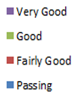
Distinctions Since 2002

Slide 57
Distinctions 2002-12 (%)

Slide 58
Postbac placement per year since 2009

Slide 59
Postbac placement per country since 2009

Slide 60
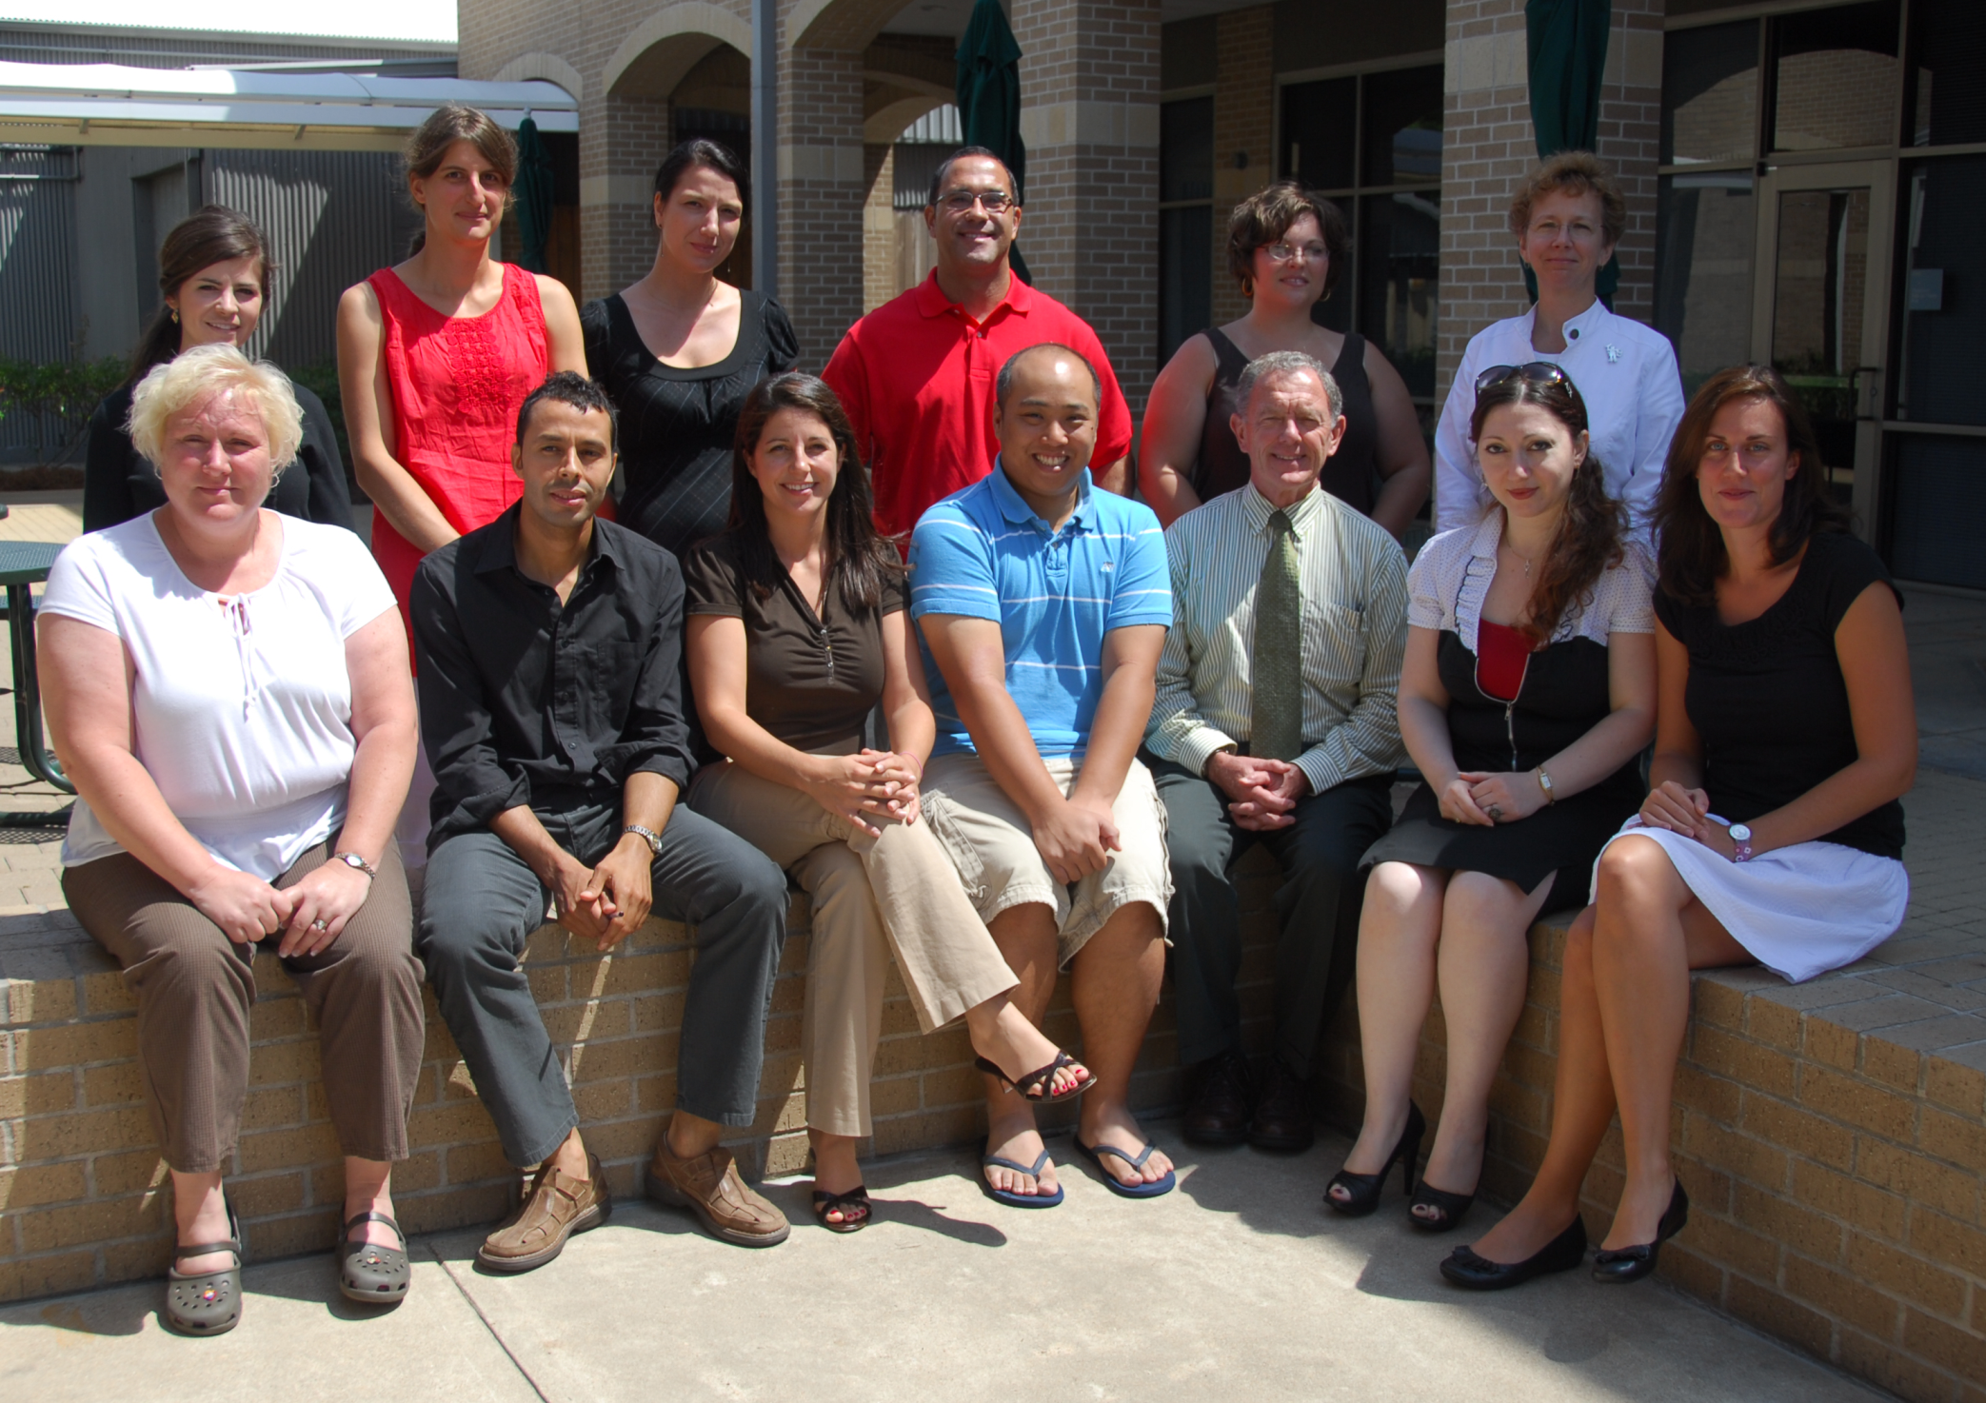
Faculty

Slide 61
Staffing for 2013-2014
2 4th Grade teachers (departure)
1 Spanish teacher (departure)
1 Economics teacher (departure)
1 Physic Chemistry teacher - (departure)
1 French teacher (new position)
2 Math teachers (new positions)

Slide 62

Promotion of the French Bac

Slide 63

Brochure made by the French Embassy in USA, and the Ministry of Education

Slide 64


Slide 65
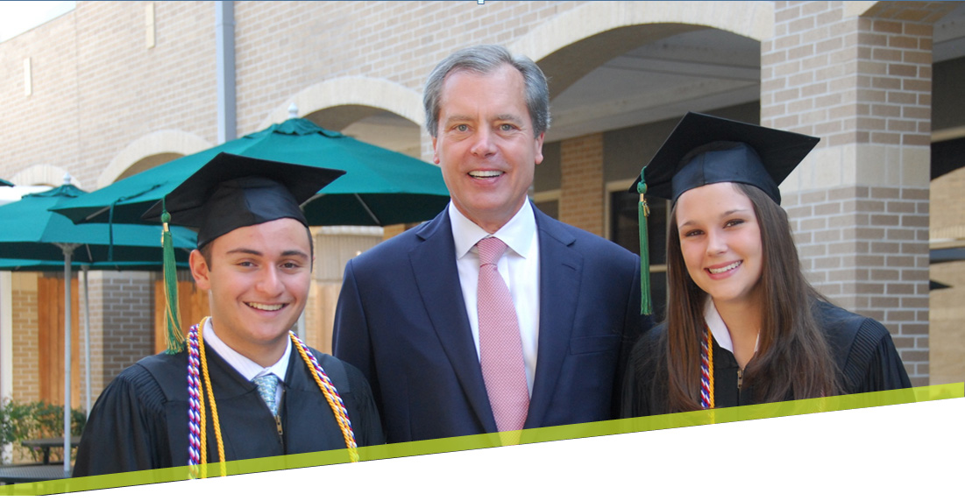
Gwen Bergman & Greg Walsh
Co-Directors of College Counseling

Slide 66
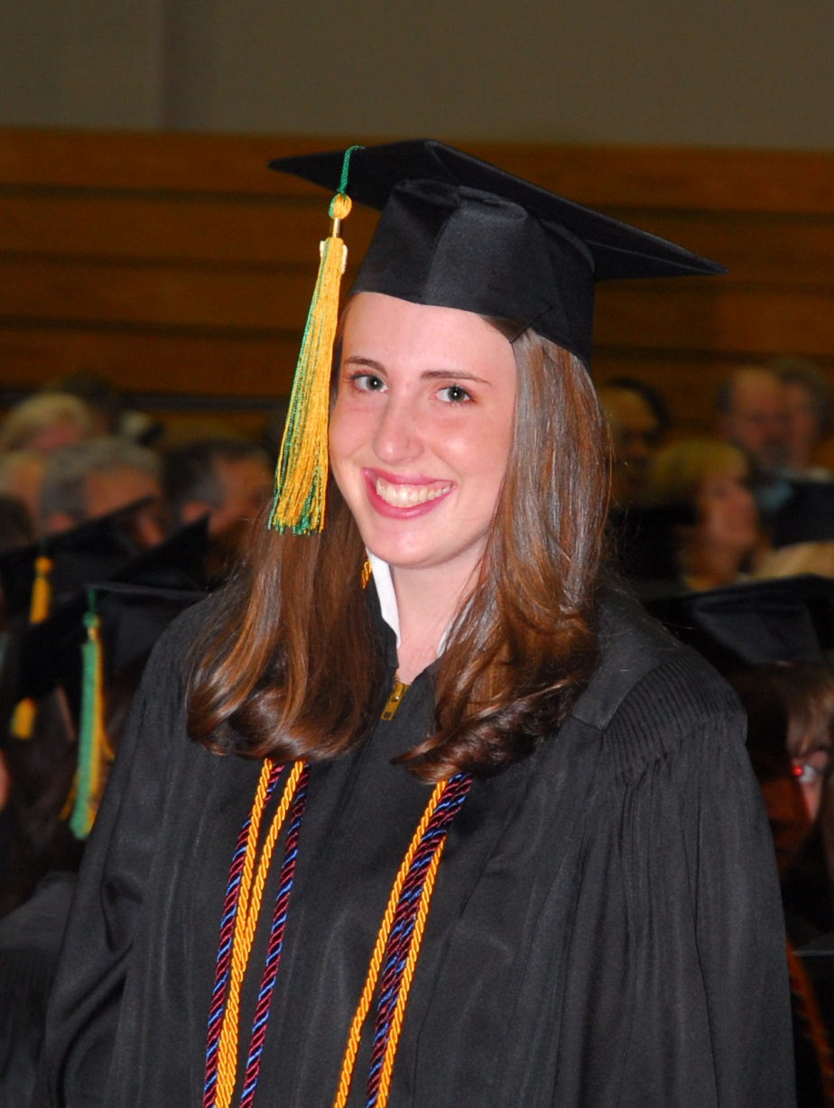
Interim Update
April 28, 2013
-About 70% of US, UK and Canadian offers and decisions are known.
-Please be aware that several students are pursuing wait list offers.

Slide 67
Preliminary College & University
News and Statistics from the Class of 2012
There are 91 students (64 IB 27 FB) in the Class of 2013
Approximately 700 college and university applications were submitted to nine different countries.
71 students applied to the USA
21 students applied to Canada
10 students applied France
9 students applied to the UK
3 students applied to Switzerland
1 student each applied to Germany, Ireland, Mexico, and Singapore
We also have helped a few alumni with new or transfer applications.
-Of those applying to the USA 56 applied either, ED, EA REA, or Rolling. There were 18 ED applications and 10 were successful. About ten students are pursuing admission off the waitlist.

Slide 68
Admits so far include (bold means likely matriculant)
USA
Agnes Scott
U Alabama
American
Austin
Babson
Bard
Barnard
Barry
Baylor (3)
Bentley (2)
Boston University
Bryn Mawr
U California Irvine
U California Los Angeles
Carnegie Mellon
Columbia U (2)
U California San Diego
U California Santa Barbara
Carnegie Mellon
Christopher Newport
U Colorado Boulder
Colorado School of Mines
Concordia (MN)
Dartmouth
U Denver
Dickinson
Drexel
Eckerd
Elon
Emory
Duke
Florida Institute of Technology
Fordham
George Mason
George Washington
Georgia Tech
Harvey Mudd
Hendrix
Hofstra
Hood
Houston Baptist
U Houston (6)
Indiana U
Johns Hopkins U
Lafayette
Lake Forest
Lewis & Clark
Loyola of New Orleans
Lynn
Macalester
MIT
NYU
Northeastern
Occidental
Oxford College of Emory
Pepperdine
U Pitt
Pitzer
U Portland
U Puget Sound
Reed
Rensselaer Polytech
Rhodes
U Richmond
U Rochester
Samford
SCAD
Smith
Rice (3)
St Edward’s
St John’s ( NY)
St Olaf
U St Thomas (2)
U Southern California
Southern Methodist University (6)
Stanford
Swarthmore
Syracuse
Texas A & M
Texas Tech
U T Austin (8*)
Trinity College (CT)
Trinity U (TX)
Tufts
Tulane (2)
U Tulsa
Vanderbilt
U Virginia
Wake Forest
U Washington
Washington U (MO)
Wellesley
Wesleyan (CT)
West Virginia U
Westminster (MO)
Williams
Worcester Polytech
* includes CAP

Slide 69
Admits so far include(bold means likely matriculant)
UK Conditional Offers
Canada
Europe
Aberdeen
Brighton
Bristol
East Anglia
Edinburgh
Glasgow
Greenwich
King’s College London
London College of Communication Met Film School
Oxford Brooks
Queen Mary London
St Andrew’s
Southampton
Sussex
University College London
U British Columbia (2)
U Calgary
Concordia
Ecole Polytechnique Montreal
HEC Montreal (3)
Laval
McGill (3)
U Montreal
U Toronto
Switzerland
Les Roches Hospitality School Franklin College
Germany
Berlin Met Film School
France
U Catholique de Lille
Mexico
Instituto Tecnologica Autonomo de Mexico

Slide 70
Special Notes:
A student was awarded the Morehead Cain Scholarship at UNC Chapel Hill, but declined. Several students were offered significant merit scholarships to schools like Case Western, Trinity (TX), Emory, Baylor, Southern Methodist, Fordham, and Rhodes.
-National Merit: four Commended students; one Semi-Finalist, one Finalist status, and two National Hispanic scholars in the Class of 2013.
-Several students were accepted into the Honors College at such places like U Houston and U Texas Austin. This year a handful of students will accept the CAP program offered by UT.
Two students will be attending a music school. One student was a recruited athlete.

Slide 71

Hank Nicodemus
Chief Financial Officer

Slide 72
Council of Independent School (CIS) Standard G1
The management of school finances shall be consistent with best practices in international schools, in accordance with the legal requirements of the host country, and shall support the effective delivery of the school’s programs.
  Understandable and regularly received financial reports
  Detailed annual budgets (operating and maintenance capital expenditures)
  Setting of tuition and fees and early communications of them
  Raising of additional funds beyond tuition
  Orderly accounting processes
  Comprehensive insurance program
  Ensure servicing of long-term debt
  Annual external audit

Slide 73
Essentials of Annual Operating Budget Process
  Pin down enrollment, financial aid, tuition remission and net annual fund proceeds.
  Enrollment determined—additional personnel? 80% of operating costs (excluding depreciation and interest) is salaries and benefits. Ongoing effort to keep medical costs under control.
  Challenge of accurately predicting operating costs of new facilities. Don Davis, Director of Facilities, has met his budget for last five years.
  Instructional expenses, about 60 categories, is a process of having the responsible parties look at history and make adjustments for new initiatives.
  Administrative—Trustees, HOS, Admissions, Advancement, Business Office, Technology, Professional Fees, etc. Justify every dollar with specific identification of items within each category.
  Supplemental income—Campus Store and Awty Plus.
Remaining Cash Flow Considerations
  Debt service
  Facility Maintenance/Technology Capital Expenditures

Slide 76
12/13 Tuition Comparison

Slide 78
Capital Expenditures 5-Year Comparison of Facilities and Technology

Slide 79
Endowment and Draw Percentage Comparison

Slide 80
Ronald Jackson
Director of Advancement and External Affairs

Slide 81
What is Advancement?
The Advancement Department and staff exist as a team to help build and sustain strong relationships in the Awty community. The following are areas of focus in order to achieve this central objective:
Alumni and Alumni Parents
Annual Giving
Capital Campaign
Communications
Events
Stewardship
Volunteers

Slide 82


Awty Alumni
Raised $7,890 from 28 alumni this year.
Alumni Challenge – The Challenge is encouraging the alumni to participate in the Annual Fund - big push in May at the alumni events.
The Awty Alumni Association Membership
For the first time this year we added a $50 membership fee to the graduating seniors school accounts.
Alumni Care Packages
In November, more than 100 care packages were sent to alumni from the classes of 2010, 2011, and 2012.

Slide 83


Volunteers
586 Approved volunteers for 2012-2013!
    Training
    Background Checks
Volunteer Appreciation Breakfast
May 15, 2013 8:00 a.m. Café South
Contact Liza Navarro 713-328-5897 lnavarro@awty.org

Slide 84
TOTAL ANNUAL GIVING

Slide 85
GALA

Slide 86
ANNUAL FUND

Slide 87
ANNUAL FUND PARENT PARTICIPATION

Slide 88
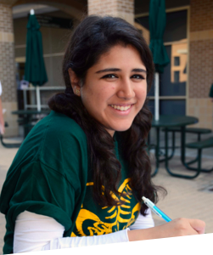

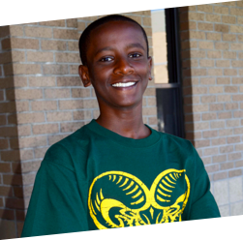
Annual Giving Shortfall
Dollars to reach goal: $82,952
If you have not given, we need your help!

Slide 89
2013-2014 Focus:
Communications
Survey to Awty Parents – May 13
Audit current publications
Welcoming New Families to our Community
New Parents Reception
Welcome Committee
Revising Orientation Events
Stewardship and Cultivation
Thanking Donors Properly
Preparing our community for a Capital Campaign

Slide 90
How Can You Help Advance Awty?
Volunteer for the Fund Raising Effort
      Experience with marketing or fund raising
Share your contacts
      Foundations
      Companies
      Insight into grants
Contact Ronald Jackson 713-328-5836 or rjackson@awty.org

Slide 91
Advancement Committee
Lisa Meacham, Chair
Ed Harris, Chair-Elect
Committee Members:
Lana Billeaud
Shelly Hendry
Jennifer Hohman
Karen Joyce
Lisa Key
Kathy Lehne
Zena Majdalani
Meredith Philipp-Tcholakian
Amy Pierce
Suneeta Rangwani
Mark Schroeder
Lorraine Talbot
Lori Vetters

Slide 92

Don Davis
Director of Facilities and Construction

Slide 93
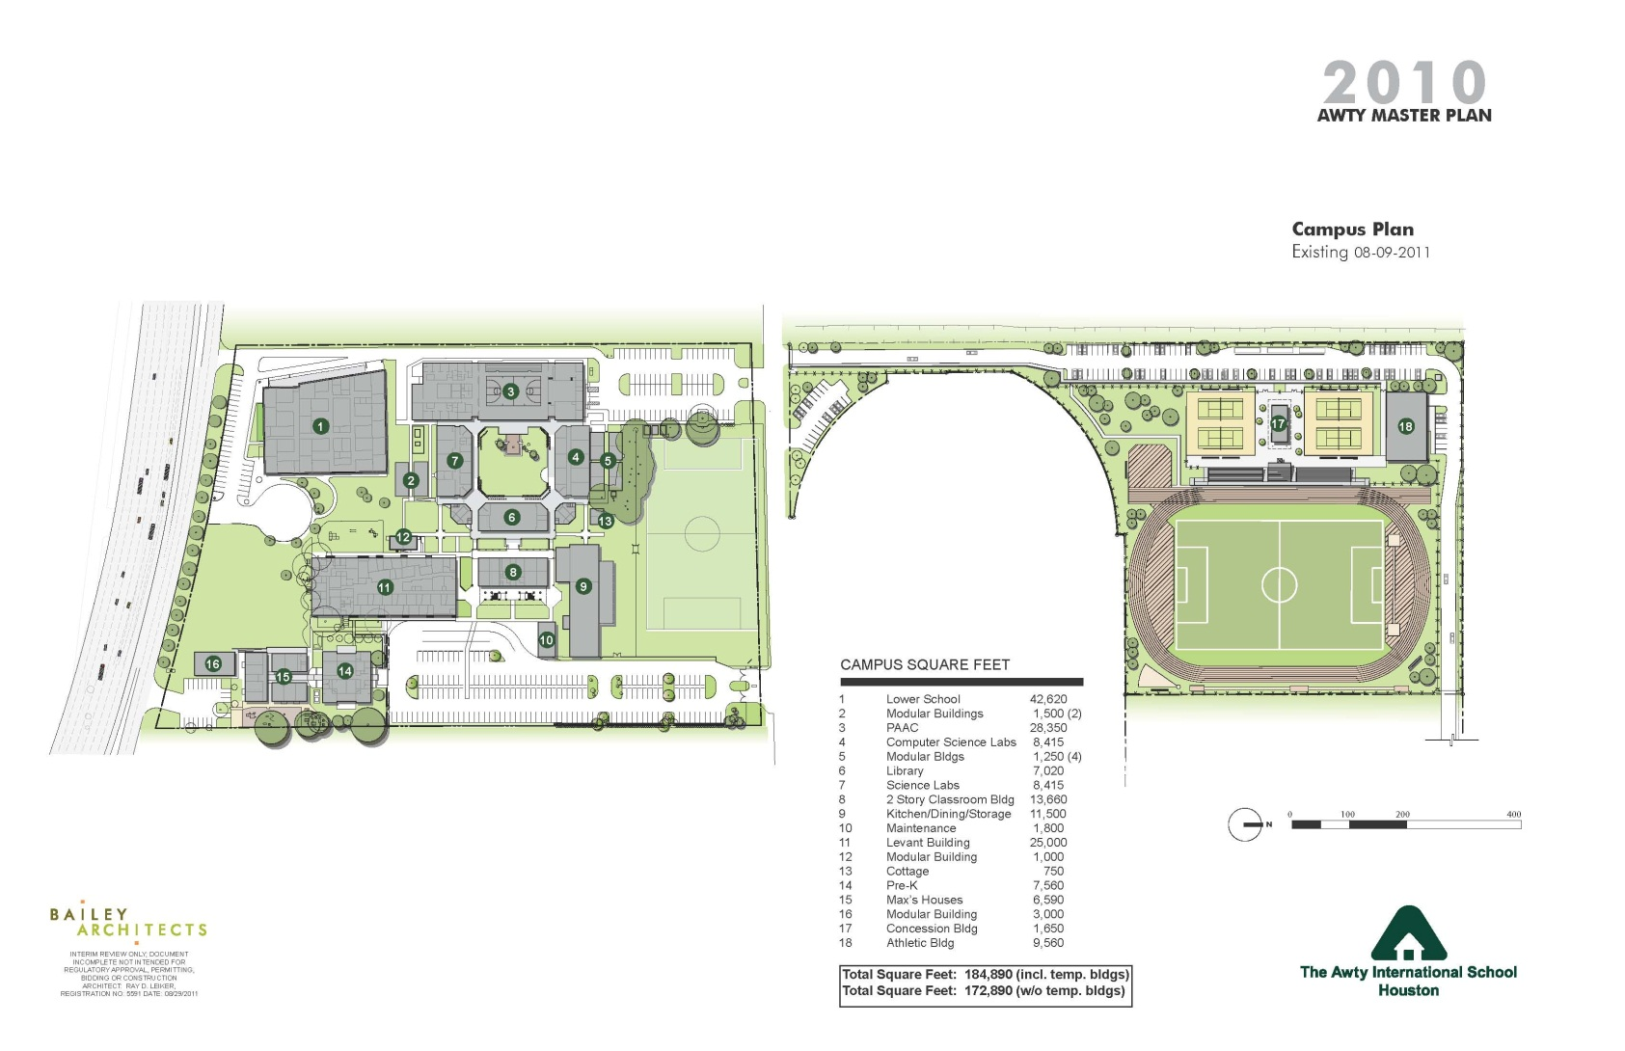
Awty Campus Plan August 2011

Slide 94
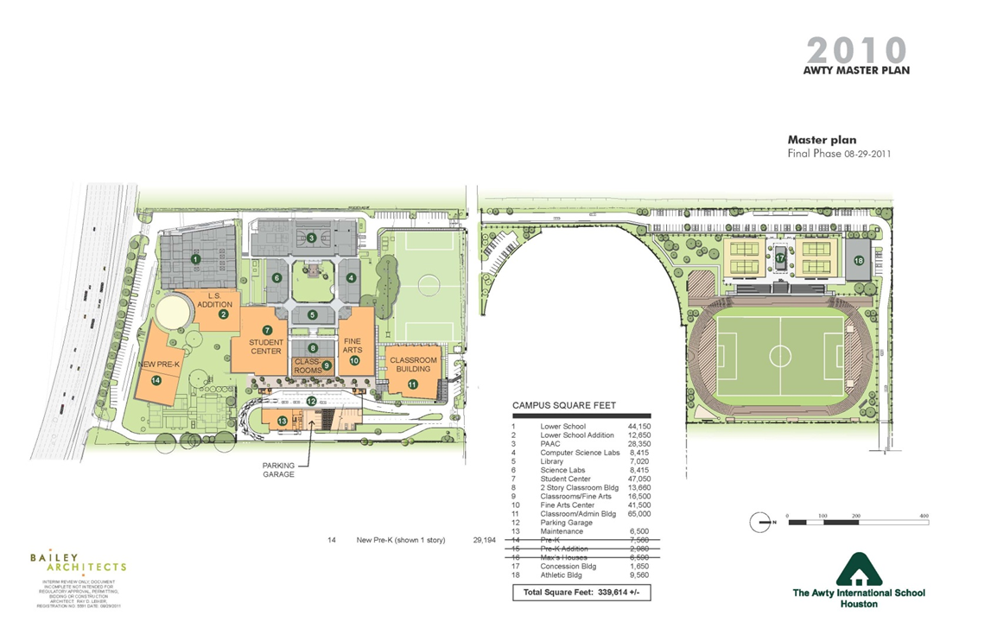
Awty Master Plan Final Phase

Slide 95
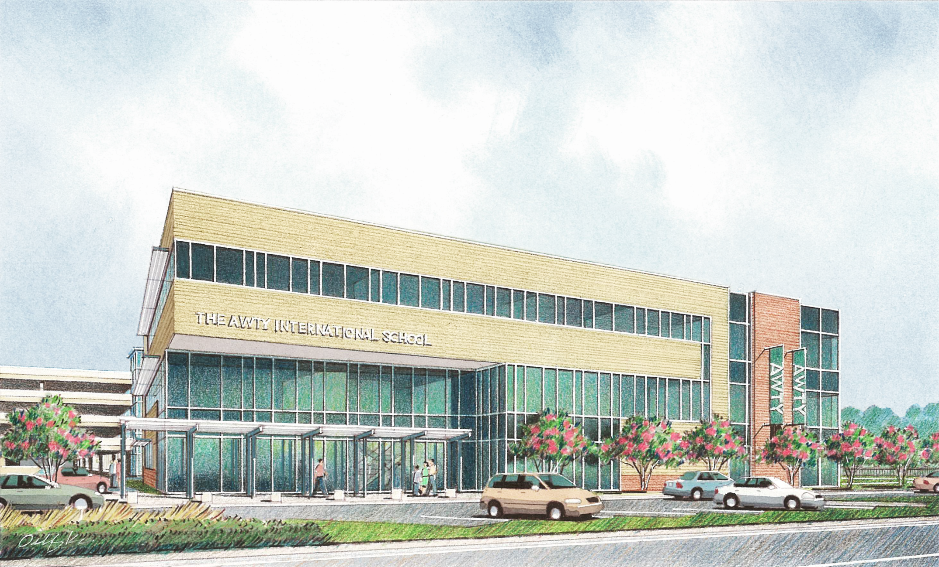
Phase I
The Levant Foundation Building

Slide 96
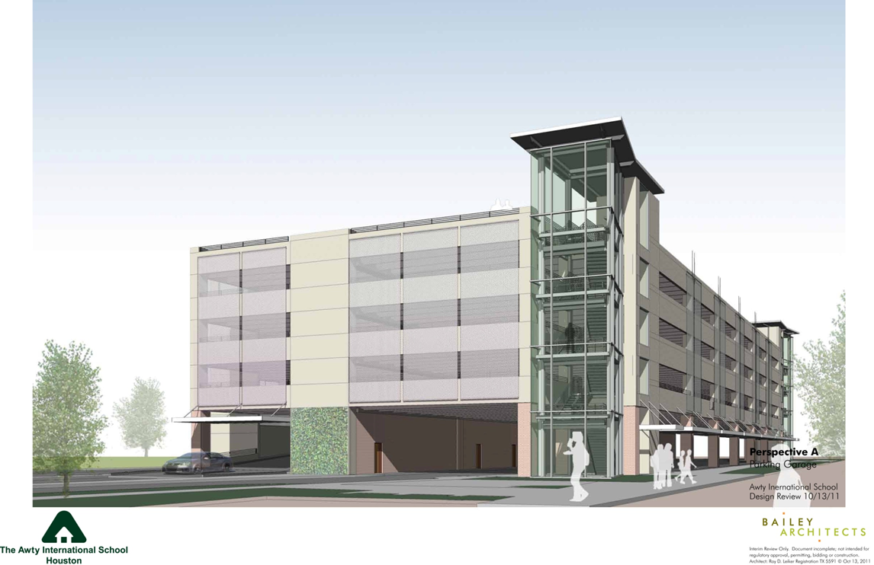
Phase II
440-Space Parking Garage and Maintenance Facility

Slide 97
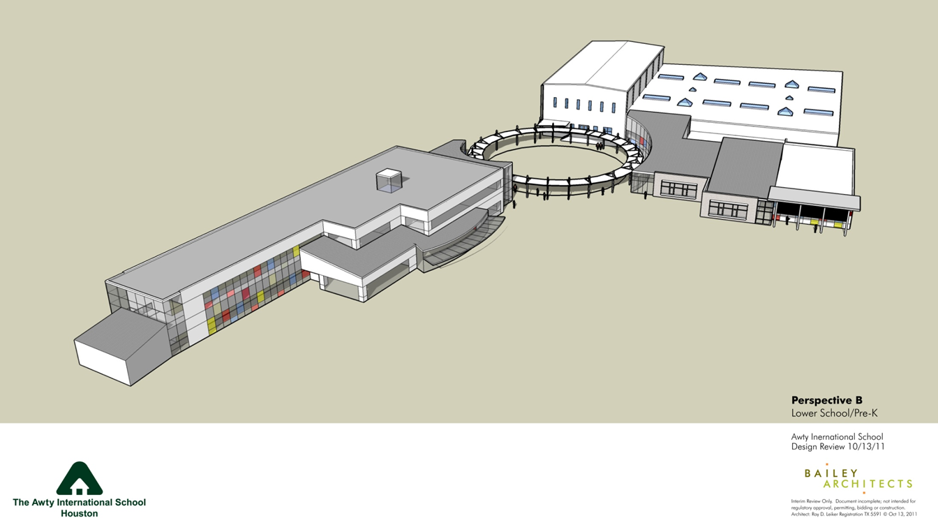
Phase II
Lower School Addition and New Pre-School

Slide 98
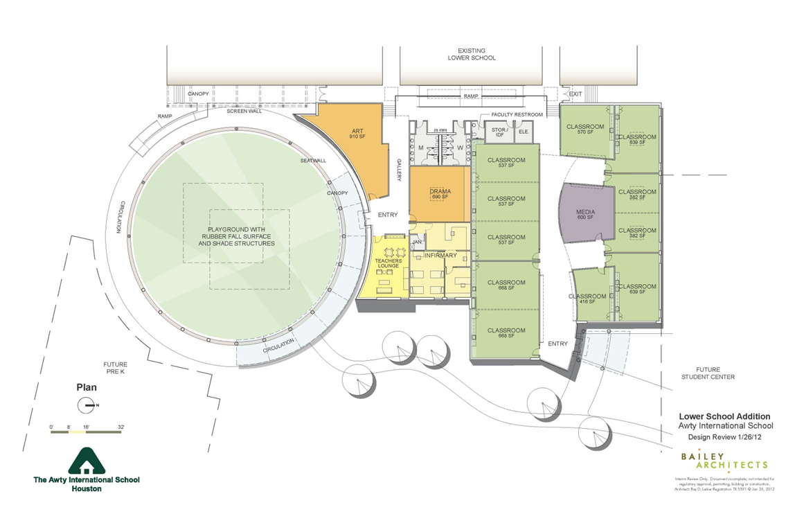
Phase II

Slide 99
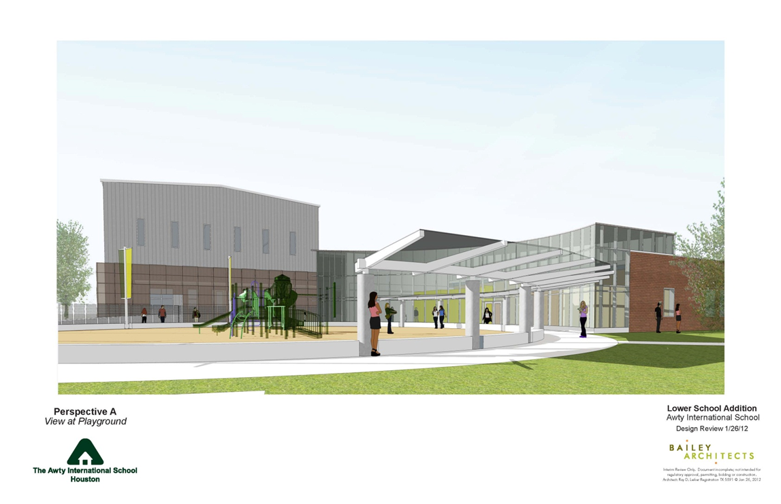
Phase II

Slide 100
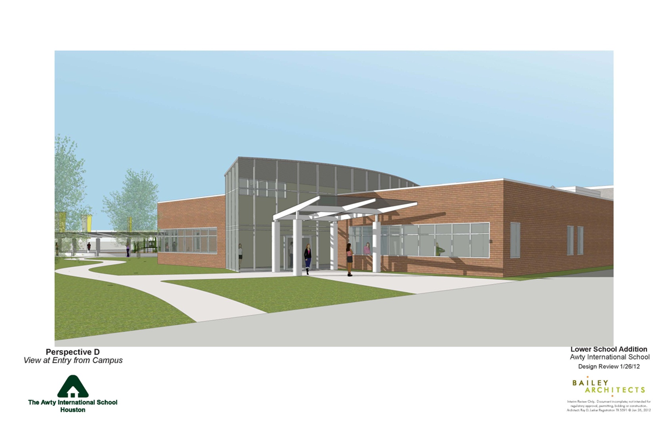
Phase II

Slide 101
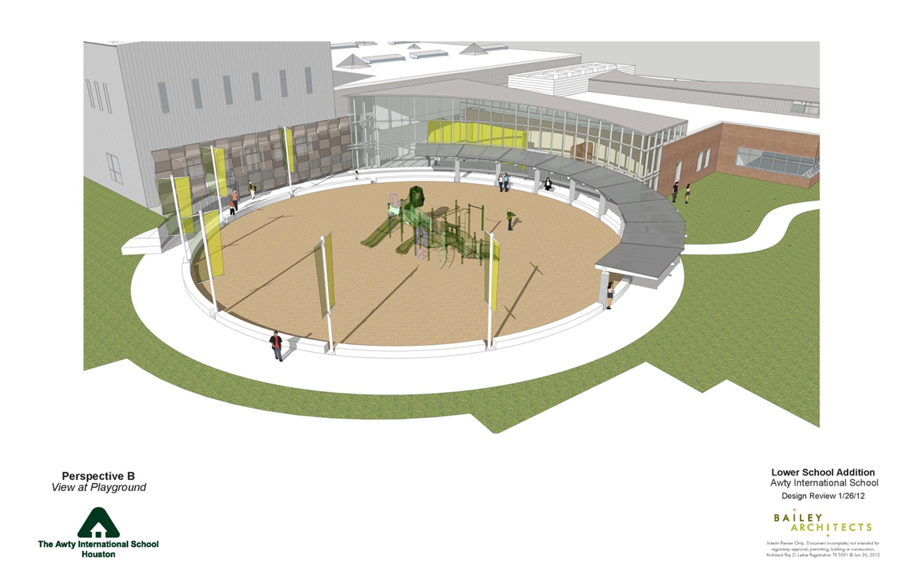
Phase II

Slide 102
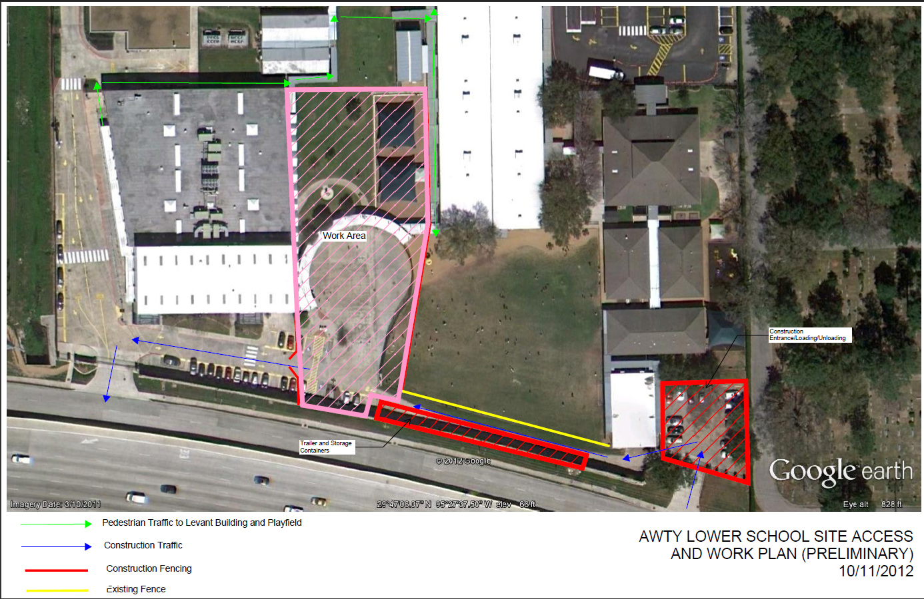
Phase II

Slide 103
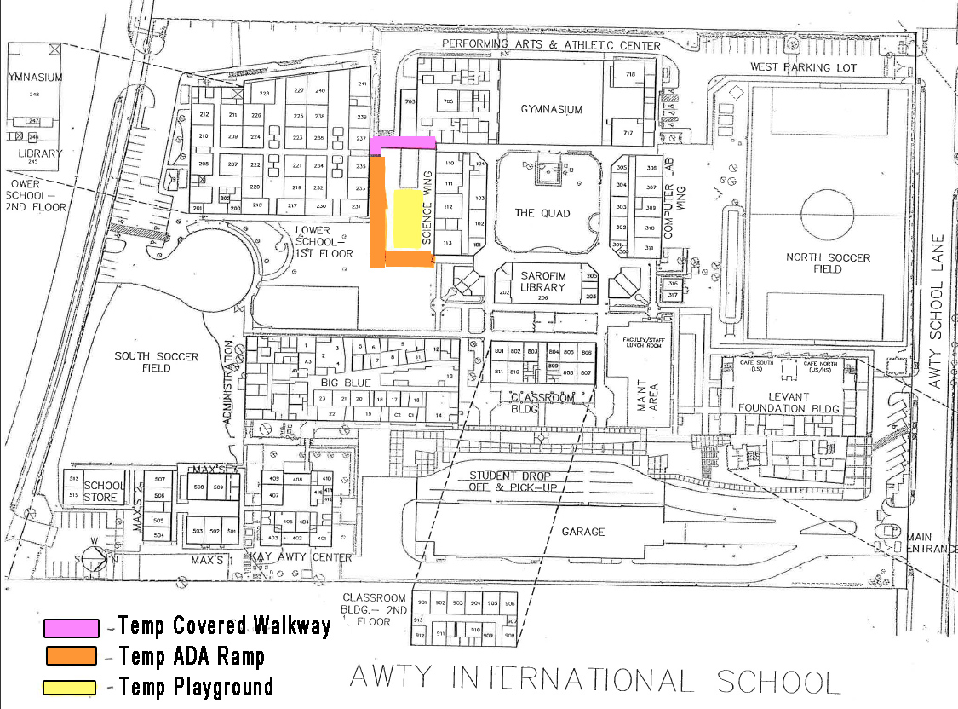
Phase II

Slide 104

Karen Joyce
Member, Board of Trustees

Slide 105
Head of School Search:
Process Underway
Leadership Transition Team overseeing process
  In place through “onboarding”
  leadership@awty.org
Wickenden Associates retained
  Chosen from “Top 4”, narrowed from field of 20+
  Highly respected; 330+ successful HoS placements, including Houston area
Focus Groups formed
  Leadership
  Faculty
  Students (Middle and Upper School Councils)
  Parents
Jim Wickenden on campus 3 days
  Met with Board, Faculty & Staff, Students, Parents
  Came away very impressed; Awty is a “hidden gem”

Slide 106
Head of School Search:
Next Steps
Seek input from wider Community
  EMAIL sent with survey link
  4 key questions
Create “Opportunity Statement”
Work Interim Head of School
Bring on Candidates
  New Head secured Jan 2014
  July 2014 start
Board develop “Charge to Head”
  Considering all input
  Key focus areas first 2 years
  Share with community

Slide 107

Mark Schroeder
Chair, Board of Trustees

Slide 108
MAJOR RESPONSIBILITIES
OF THE BOARD:
Supervise and manage the Board’s sole employee, The Head of School
Look after the school’s financial soundness
Set long-range strategic objectives
Raise money
The Board does not manage the day-to-day affairs of the school

Slide 109
A REVIEW OF SOME OF THE MAJOR ACTIVITIES OF THE PAST YEAR:
December 1, Board expressed its support for adoption of the PYP Program for the international curriculum of lower school
Approved a 4% increase in tuition for 2013-14
Approved enrollment and average class size figures for lower, middle and upper school international curricula and addressed French curriculum enrollment
Approved budget for 2013-14
Approved ground-breaking for lower school addition

Slide 110
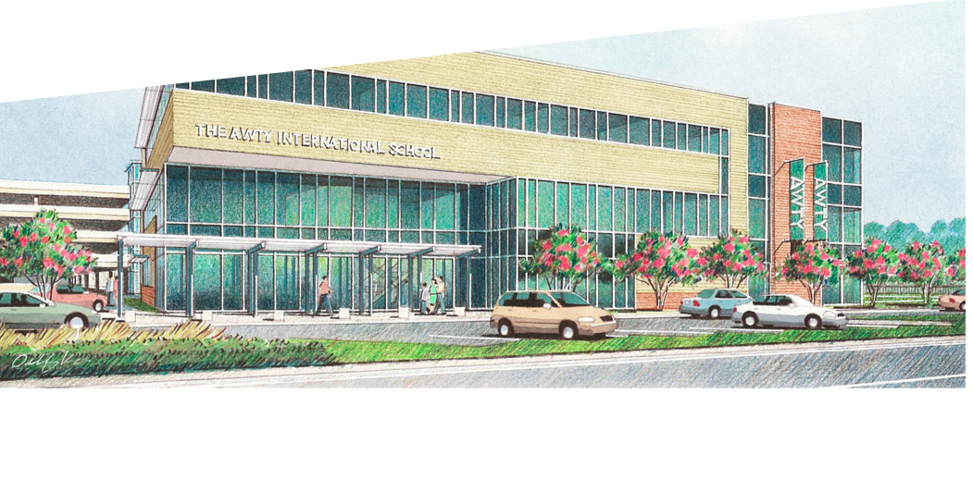



Questions?

